Slide 1

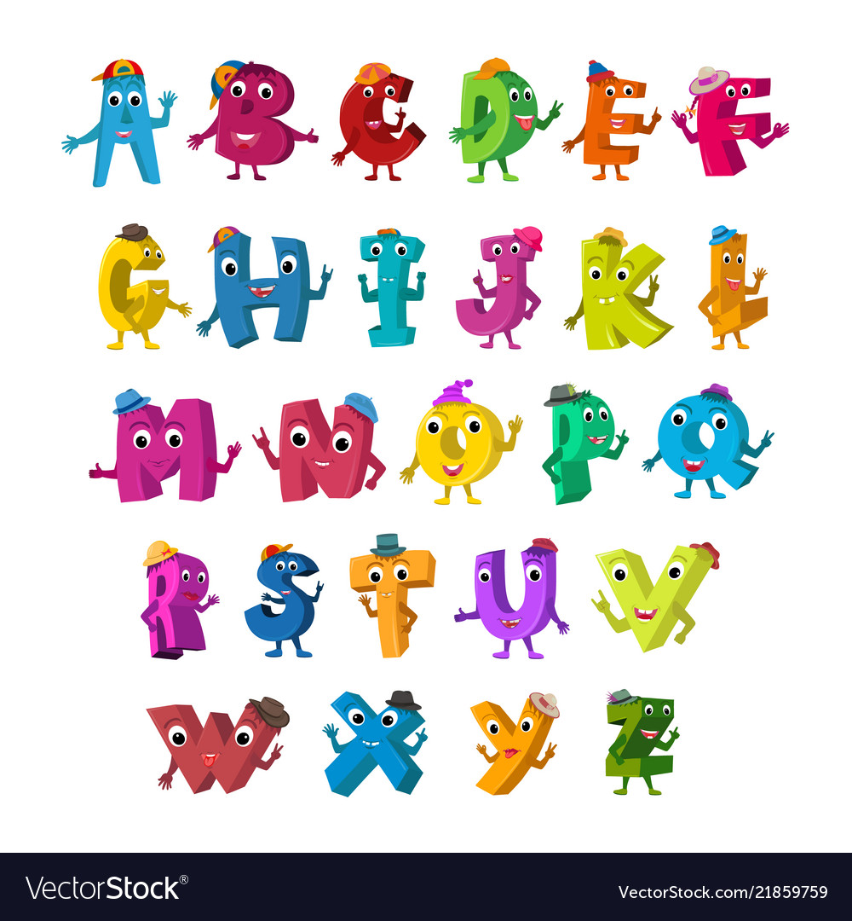
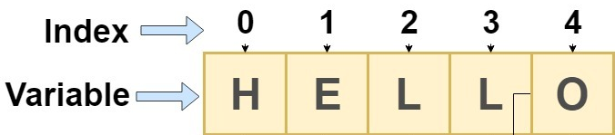
Math Class
Characters & Strings

Slide 2
Check In
Arrange seats to face front screen
Industry Panel Feb 12th/13th
Quiz Module 01 moved to Feb 17th/18th
Have you found a group to collaborate outside of class?
Goals
Characters and Character Class
String Type and String Methods
Reading Strings and Characters
For today’s lecture go to your eclipse project and create a class called M02L06MathChars in your IDE.

Slide 3
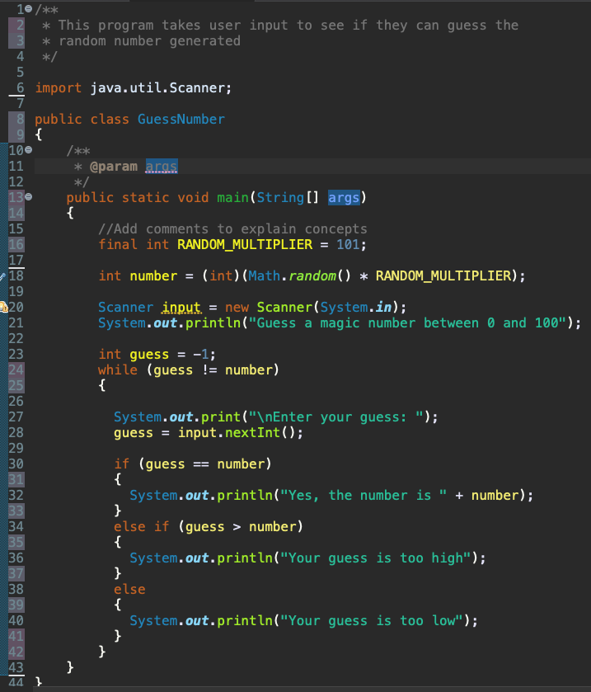
Connecting Vocabulary and Code
Give example from the code and brief understanding. Include line number from code.
Java package
Java Class
Predefined class
Create Object instance from predefined class
Use class method without creating object
Method, Parameters, Return value
Data type
Declaring and initializing a variable
Allocating memory
Variable
Constant
Assignment operator
Identifier
Comments

Slide 4


Classes and Objects
A class is a blueprint used to construct an object – It defines an object’s attributes and behaviors
A class is not an object. An object is created using the blueprint of the class. It is an instance of the class.
For now, we will use classes that are predefined in the Java language to create objects.
Import util package and scanner class
Create an object from that class
Use methods defined for that object
Makes Scanner class blueprint available in program.
Data type
Assign newly constructed object to variable identifier.
Construct object to read from keyboard (system input stream)
Data type
Assign inputted double to variable identifier
Use object to call method from class blueprint that returns value

Slide 5
Math Class
Math class is different! We DO NOT create a Math object like we do for Scanner class.
You will NOT need the following when using the Math class
Math myMath = new Math();
If you try this the compiler will complain with something like "The constructor is not visible"
A constructor is a method that is called to "create" an object
The reason the above error happened
Because in the Math class this "constructor" method is private
You don't have access to private methods in a class
How can we use the Math class if we cannot create a Math object?
ALL methods in the Math class are what we call static methods
Static methods
Allow you to call the methods in a class without creating an object of the class
Are NOT associated with a specific object of the class
To call static methods you use the class name: Math.random()
You will learn more about constructors later in the course

Slide 6
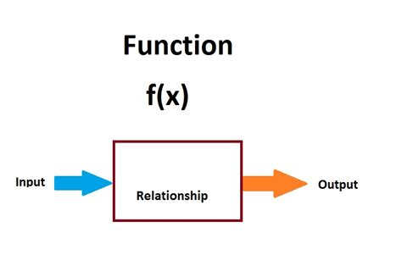
Math Methods
Using methods that have been pre-defined in Java to perform mathematical functions. Someone wrote the code for you!
Math Class
Provides methods that perform mathematical calculations beyond the basic operators +, -, *, /, %
The Math class is part of the java.lang package – which means it is imported by default!

Slide 7
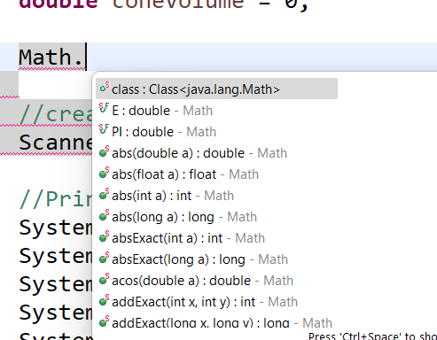
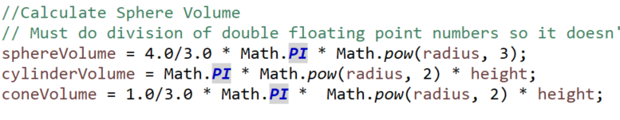
Introduction to Math Class
There are two constants in the Math class
PI => 3.14159… (This means you do not need to declare PI as a constant)
E => 2.71828... (base of natural log)
Class methods:
Trigonometric Methods
Exponent Methods
Rounding Methods
min, max, abs, and random Methods
Typing Math. you can see what is in the Math Class

Slide 8
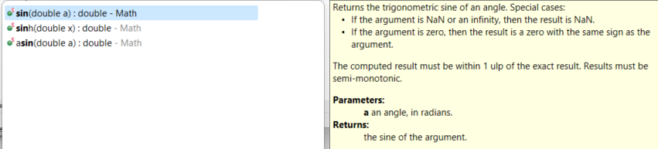
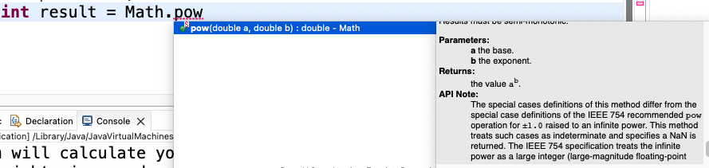
Methods: parameters and return values
double exponentResult = Math.pow(base, power);
System.out.println("result = " + exponentResult);
The values passed to the pow method in the Math class are arguments or actual parameters. The method will return the results to be stored in the variable exponentResult.
The methods signatures define formal parameters, which are placeholders for values that will be passed into the method when it is called. This method returns a double.

Slide 9
More Math Methods
Exponent Methods
exp()
log()
log10()
pow()
sqrt()
Rounding Methods
ceil() - Rounds x up to nearest integer
floor() - Rounds x down to nearest integer
rint() - Rounds x up to nearest integer - if equally close to two integers - returns even one
round() Returns int if x is a float or returns long if x is a double rounded to nearest integer value
Long round()
More
max()
min()
abs()
random()
Resource when you need to use a math method Java Math class with Methods - Javatpoint

Slide 10
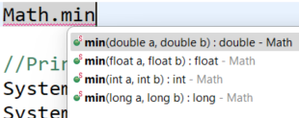
Overload Methods
If a class has multiple methods having same name but different parameters, it is known as Method Overloading.
If we have to perform only one operation, having same name of the methods increases the readability of the program.

Slide 11

Explore Math random method
Add the following code to your class.
Set a breakpoint and debug to see what is stored in the variables each time each time.
Using the Math class random method to generate random numbers.
What is (int) doing?
double randomDouble = Math.random();
int randomInt = (int)randomDouble;
randomInt = (int)(randomDouble * 10);
randomInt = (int)(randomDouble * 10 + 1);

Slide 12
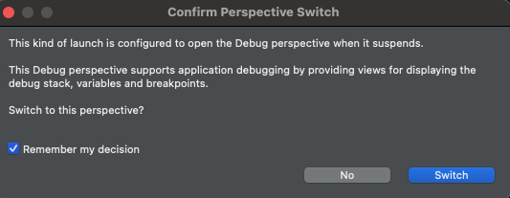
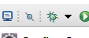
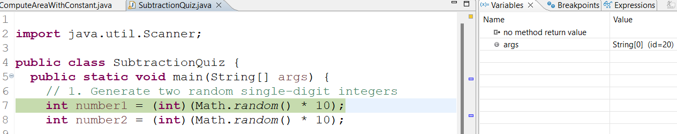
Debugging and Stepping Through Each Line of Code
Using the debugger is an important skill to help you not only fix bugs but understand what the code is doing. It allows you to step through each line of code and see what is being stored in the variables. Resources: Using Eclipse Debugger and Debugging in Eclipse Documentation
1. Double click next to the line number you want to pause to step through code
2. Click debug button and if asked switch to debug perspective check remember my decision
3. You will see the statement highlighted to show what statement you will start stepping through.
There should be a window to see the variables.

Slide 13


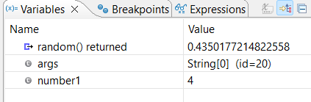
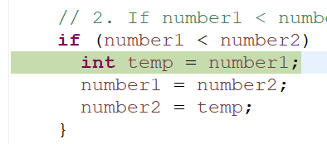
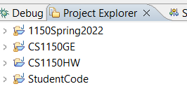
Debugging Part 2
4. Now you can step through program using step over
5. Notice what happens after you execute
6. A variable was create in memory and assigned 4.
7. Continue stepping until you get to the if statement to see the condition and what code runs. Run the program until number1 < number2 is true and notice the temp variable is created. Watch the variable window to see what happens when you exit the if block.
Can you explain?
You can toggle back to project explore and remove breakpoints.

Slide 14
Explore and Debug Random Method
Using the Math class random method to generate random numbers. Returns a double value with a positive sign, greater than or equal to 0.0 and less than 1.0.
0 <= Math.random() < 1
What results from casting to int?
multiply by 10?
Add 1?
Book Examples: 2.9. Using the Math Class and generating Random Numbers

Slide 15
Create Random Integers
a + Math.random() * b returns random number between a and a+b -1
Add code to create random number between two constants MIN and MAX assigned 1 and 12.
Use printf to display the Random value for month between [MIN] and [MAX] is [randomMonth]
0
Between 0 and 9
Here is an algorithm to create random numbers between a MAX and MIN
Put in your tech document!
Between 1 and 12

Slide 16
More Data Types
Data Type
Tells the compiler what type of data is stored in a variable
Integer variables - byte, short, int, long
Floating-point variables - float, double
Boolean variable – boolean (values are true, false)
Char Data Type
Use single quote to represent a character (doubles quotes are for Strings)
A char variable can hold one single character
char middleInitial = 'M'; // Assigns the character 4 to numCharacter
Note: If you place a single character in double quotes it is no longer a char it is a String
char middleInitial = "M"; // Error - cannot convert String to char

Slide 17
Explore Chars
Add the following code then change the charTest character to different characters from ASCII Table. Try some special char such as ‘\n’
char middleInitial = '1';
int charIntValue = 1;
System.out.println(middleInitial);
charIntValue = (int)middleInitial;
System.out.println(charIntValue);
Resource: Java Char Keyword - Javatpoint

Slide 18
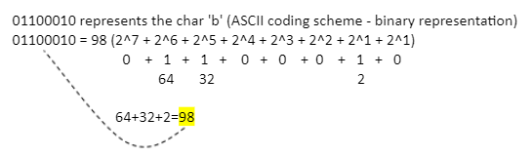
Char Unicode and ASCII Code
Encoding: you are using something to represent something else
With Unicode and ASCII code a binary representation maps to a char
Unicode
16-bit character scheme (which can store the char data type)
Encodes every possible language - so it is huge!
Requires more space than ASCII
Includes ASCII code
UTF-8 one of the widely-used encodings
Basically, Unicode is a way to assign to each character a unique number, or code point
Read http://kunststube.net/encoding/
ASCII (American Standard Code for Information Interchange)
8-bit character scheme - shown above for b
Provides encoding for 128 characters
Based on ordering of English alphabet
Superseded by UTF-8

Slide 19
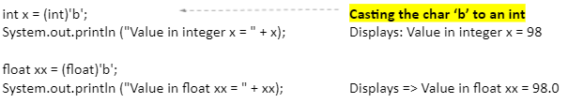
Casting
char can be cast to numeric values (byte, short, int, long, float, double)
Takes the character's Unicode and casts it into a numeric value
Numeric values (byte, short, int, long, float, double) can be cast to char
Only lower 16 bits are cast into char - other bits ignored

Slide 20
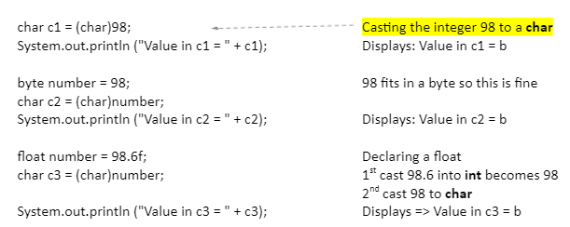
Casting
Look at the ASCII Code table
Numeric values (byte, short, int, long, float, double) can be cast to char
Only lower 16 bits are cast into char - other bits ignored

Slide 21
Explore Chars
Add code to read in character.. Then print if it is and the ascii value
Scanner input = new Scanner(System.in);
System.out.println("Enter a char");
char someChar = input.next().charAt(0);
System.out.printf("A char was entered with ascii value %d \n", someChar);

Slide 22

String Data Type
A sequence of characters is considered a string
Use double quote to represent a string
String is different from the other data types because
it is NOT a primitive data type
it is an object – the reason it is capitalized - predefined class like Scanner, Math, System, Character etc
For now, declare a reference variable to be a String and then perform actions on that variable in this way.
String studentName = "Silly Willy";
String studentName = new String("Willy Nilly"); // Will explore this later in the course
Not using this way
Put in your code
String firstName = "Willy"; //declare and initialize a string this way.

Slide 23
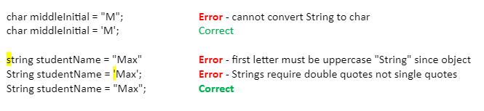
String and char
Remember a char is in single quotes and a String is in double quotes

Slide 24
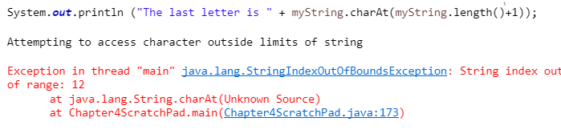
String Methods
length() Returns the number of characters in a string – for above string this is 5
charAt(index) Returns the character at the specified index within a string
Ends at length of string -1 since starts at position 0 the last index is 4 = 5-1
char
W | i | l | l | y
0 | 1 | 2 | 3 | 4
Index in string
Starts at position 0
Put in your code
Put in your code
Notice what happens if you try to access an index that doesn’t exist. For example there is nothing at index 6

Slide 25
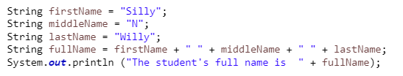

Concatenating Strings
The Java String class concat() method combines specified string at the end of this string. It returns a combined string. It is like appending another string.
Use plus sign (+) to concatenate strings or use concat(string1)
Converting Strings.
toLowerCase ()
Returns a string that is in all lowercase
toUpperCase ()
Returns a string that is all uppercase

Slide 26
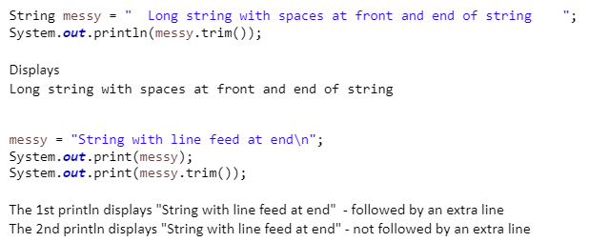
Trim String White Space Characters
trim()
Returns a string with all white space characters removed from front or end of string
White space characters include space, tab, line feed, form feed, carriage return,

Slide 27
CS Career Panel
Introduction to Careers in CS
Overview of career pathways and opportunities for CS graduates.
Practical advice for navigating internships, networking, and first jobs.
How Fundamentals Shape Real-World Development
The importance of programming basics in professional settings.
Stories of how loops, arrays, and methods solved real problems.
Diverse Pathways in Computer Science
Highlighting non-linear career journeys and diverse roles.
Advice from professionals in varied domains like cybersecurity, data science, and software engineering.
Soft Skills for Success
Importance of communication, teamwork, and adaptability in CS careers.
Tips for collaboration and lifelong learning.

Slide 28
Preparation
Go to today’s lecture in canvas
Quiz - Review next lecture

